Slide 1
Logistic Regression
Notes:
Logistic regression is used in various fields, including machine learning, most medical fields, and social sciences. For example, the Trauma and Injury Severity Score (TRISS), which is widely used to predict mortality in injured patients, was originally developed by Boyd et al. using logistic regression.^{[3]} Many other medical scales used to assess severity of a patient have been developed using logistic regression.^{[4][5][6][7]} Logistic regression may be used to predict the risk of developing a given disease (e.g. diabetes; coronary heart disease), based on observed characteristics of the patient (age, sex, body mass index, results of various blood tests, etc.).^{[8][9]}Another example might be to predict whether an Indian voter will vote BJP or Trinamool Congress or Left Front or Congress, based on age, income, sex, race, state of residence, votes in previous elections, etc.^{[10]} The technique can also be used in engineering, especially for predicting the probability of failure of a given process, system or product.^{[11][12]} It is also used in marketing applications such as prediction of a customer's propensity to purchase a product or halt a subscription, etc.^{[13]} In economics it can be used to predict the likelihood of a person's choosing to be in the labor force, and a business application would be to predict the likelihood of a homeowner defaulting on a mortgage. Conditional random fields, an extension of logistic regression to sequential data, are used in natural language processing.

Slide 2
Introduction to Logistic Regression
Logistic regression is used in various fields, including machine learning, most medical fields, and social sciences.
For example, the few injuries are classified based on logistic regression.

Slide 3
Introduction to Logistic Regression
Many other medical scales used to assess severity of a patient have been developed using logistic regression.
Logistic regression may be used to predict the risk of developing a given disease (e.g. diabetes; coronary heart disease), based on observed characteristics of the patient (age, gender, body mass index, results of various blood tests, etc

Slide 4
Introduction to Logistic Regression
The technique can also be used in engineering, especially for predicting the probability of failure of a given system or product.
It is also used in marketing applications such as prediction of a customer's propensity to purchase a product or halt a subscription, etc.

Slide 5
Introduction to Logistic Regression
Another example might be to predict whether an Indian voter will vote BJP or Trinamool Congress or Congress, based on
age,
income,
gender,
state of residence,
votes in previous elections, etc.

Slide 6
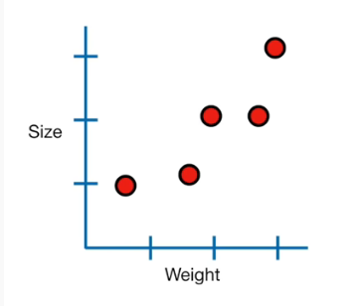
In Linear regression,
We had some data - Weight and Size
Then we fit a line to it
And with that line, we could do a lot of things:
Calculate R² and determine if weight and size are correlated
Calculate a p- value to determine if R² value is statistically significant
We can use the line to predict size given weight

Slide 7
Use data to predict something falls under the category of machine learning

Slide 8
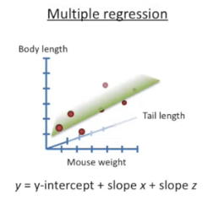
Multiple regression did the same thing that simple regression did
Calculate R²
Calculate a p- value
Predict size given weight and Tail length

Slide 9
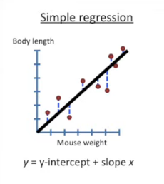

Slide 10
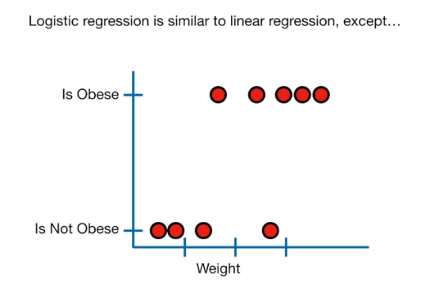

Slide 11
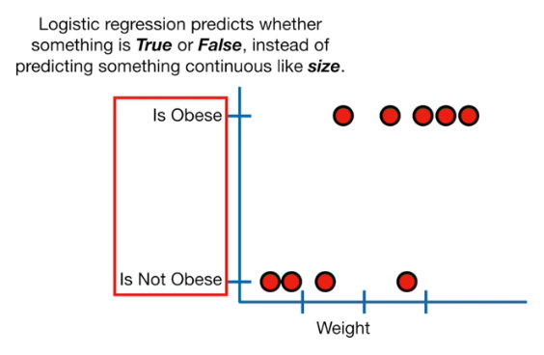

Slide 12
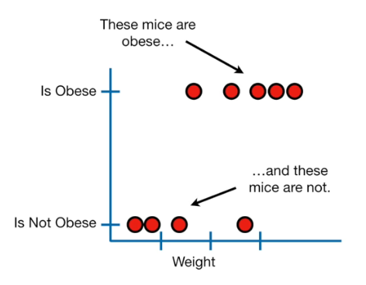

Slide 13
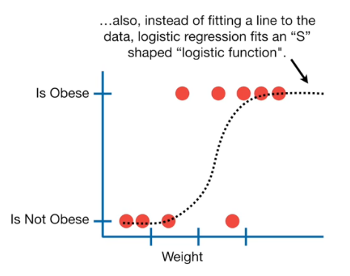

Slide 14
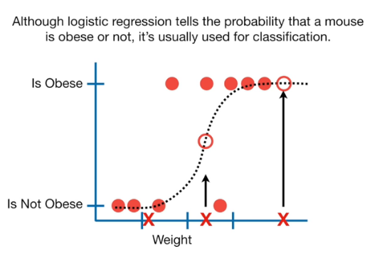

Slide 15


Slide 16
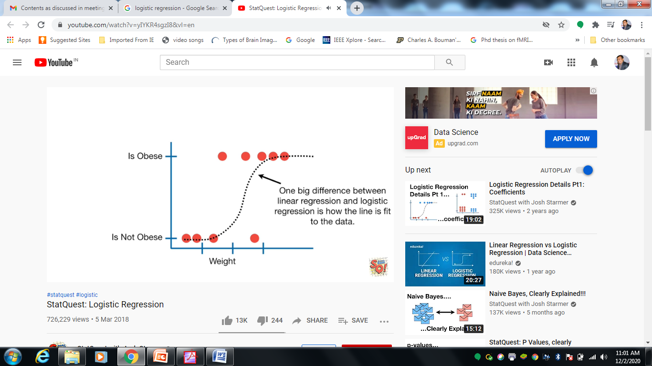


Slide 17


Slide 18




Slide 19

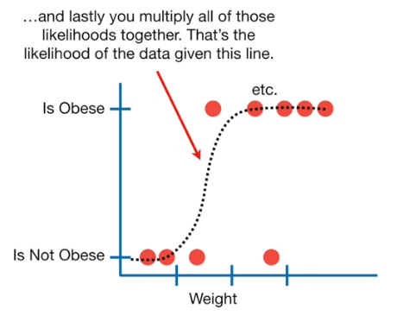

Slide 20
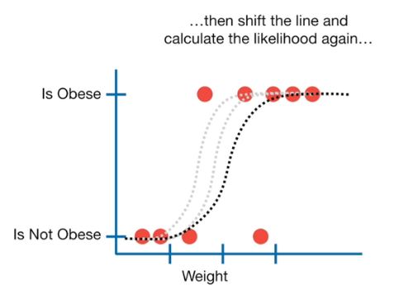
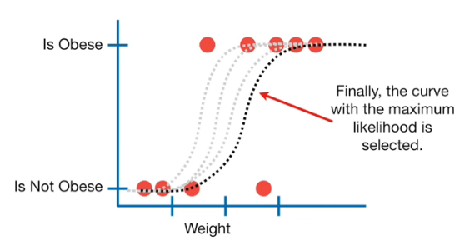

Slide 21

Logistic Regression (LR)
Salary
+
+
+
+
+
+
+
+
+
+
+
+
+
+
$$y=Ѳ_{0}+Ѳ_{1}x_{1}$$
Experience
We know

Slide 22
Logistic Regression (LR)
Action
1
+
+
+
+
+
+
+
+
+
+
+
? ? ? ?
0
+
+
+
+
+
+
+
+
+
+
Age
We don’t know

Slide 23
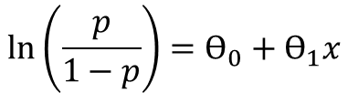
Logistic Regression (LR)
Action
1
+
+
+
+
+
+
+
+
+
+
+
$$\ln\left(\frac{p}{1−p}\right)=Ѳ_{0}+Ѳ_{1}x$$
0
+
+
+
+
+
+
+
+
+
+
Age
Notes:
Logistic regression is a predictive modelling algorithm that is used when the Y variable is binary categorical. That is, it can take only two values like 1 or 0. The goal is to determine a mathematical equation that can be used to predict the probability of event 1. Once the equation is established, it can be used to predict the Y when only the X’s are known.

Slide 24
Algorithm for Logistic Regression (LR)
Import the libraries
Import the dataset
Splitting the dataset into the Training set and Test set
Perform Feature Scaling
Fitting Logistic Regression to the Training set

Slide 25
Algorithm for Logistic Regression (LR)…
Predicting the Test set results
Making the Confusion Matrix
Visualising the Training set results
Visualising the Test set results
End

